Slide 1
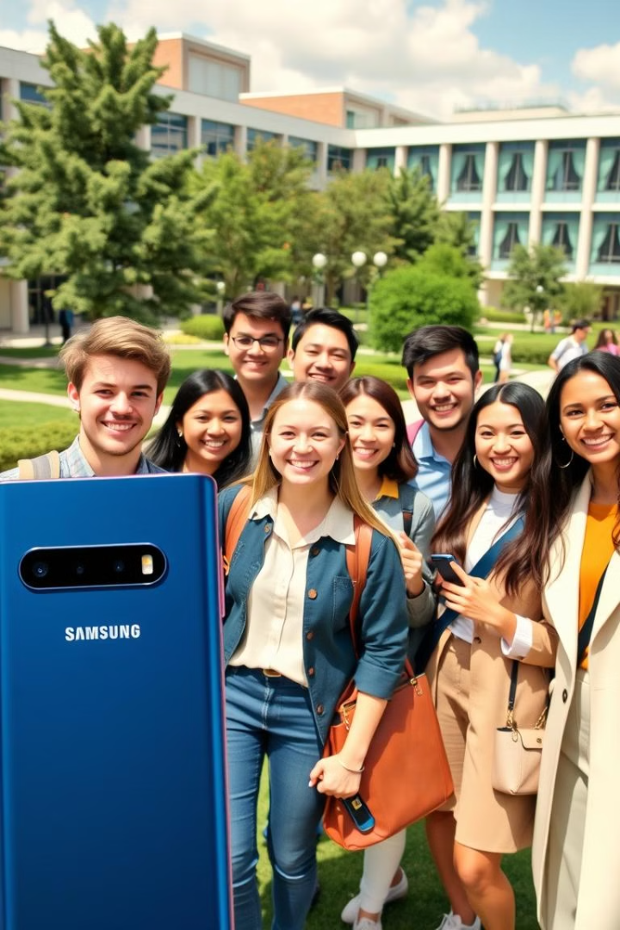
Samsung Innovation Campus Platform : A Platform for Student Success
Welcome to Samsung Innovation Campus, a global initiative dedicated to empowering students with the skills and knowledge they need to succeed in the technology-driven world. This platform is designed to connect students, foster collaboration, and provide opportunities for growth and development.

Slide 2

The Need for a Social Media Platform
The Samsung Innovation Campus platform provides a dedicated space for students to connect, collaborate, and share their experiences. This social media platform acts as a virtual community for students, encouraging engagement and collaboration in a supportive and inclusive environment.
Shared Learning
Community Building
Facilitates knowledge exchange and problem-solving through discussion forums, group projects, and mentorship programs.
Fosters a sense of belonging and connection among students through shared experiences and online events.
Networking Opportunities
Connects students with industry professionals, potential employers, and other stakeholders.

Slide 3
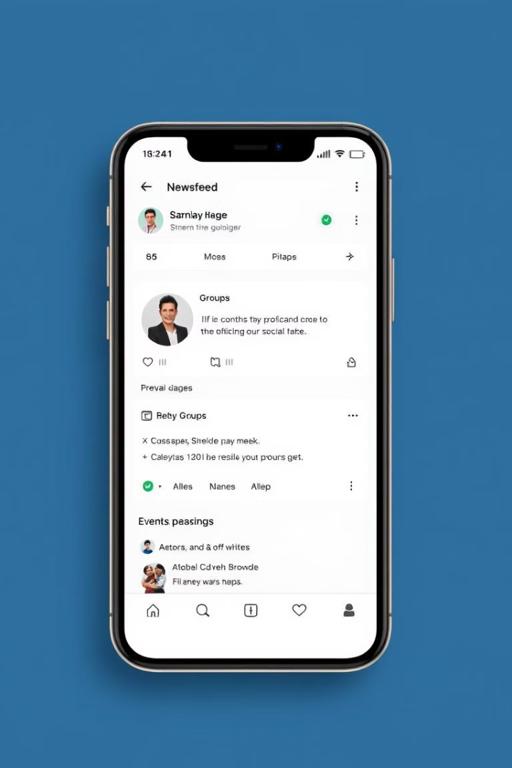
Key Features of the Platform
The Samsung Innovation Campus platform offers a comprehensive suite of features designed to enhance student learning and engagement.
1
Interactive Forums
2
Project Collaboration Tools
Dedicated spaces for students to ask questions, share ideas, and engage in discussions on various tech topics.
Allows students to work together on projects, share files, and collaborate in real-time.
3
Personalized Learning Resources
4
Mentorship Programs
Connects students with experienced industry professionals who offer guidance and support.
Provides access to curated content, including articles, videos, and interactive exercises, tailored to individual learning needs.

Slide 4
Benefits for Students
The platform offers a wide range of benefits for students, empowering them to reach their full potential.
Skill Development
Career Advancement
Global Connections
Access to industry-relevant resources, workshops, and mentorship opportunities help students develop the skills needed to succeed in the tech industry.
Networking opportunities, industry connections, and access to job postings provide students with a competitive edge in the job market.
The platform fosters connections with students from all over the world, broadening perspectives and promoting intercultural understanding.

Slide 5

User Engagement and Community Building
The platform fosters a sense of community and belonging by encouraging user engagement and active participation.
Community Forums
Dedicated spaces for students to share their experiences, ask questions, and support each other.

